Slide 1
Bias-preserving gates with stabilized cat qubits
汇报人：余轲辉
指导老师：李宏荣、王信
2021 年 9 月

Slide 2

Question
What do we need on the road to fully universal quantum computing ?

Slide 3
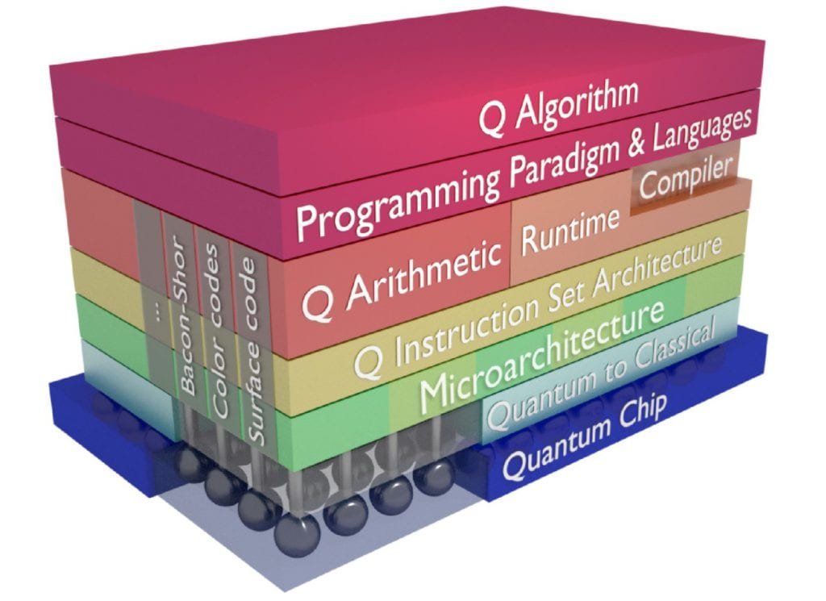
Background
7-layer configuration
Q Algorithm
Programming Languages
Q Arthmetic
Q Instruction Set
Microarchitecture
Quantum to Classical
Quantum Chip
The basis of this architecture is quantum chip (superconduncting quantum circuits, quantum dots)
The middle part between the chip and the algorithm translates the quantum algorithm into control pulses acting on the physical chip.
Quantum bits are extremely fragile. The way forward is to correct the errors faster than they appear, a notion called fault-tolerance.
The approach to achieve fault-tolerant quantum computing is based on Quantum Error Correction.

Slide 4
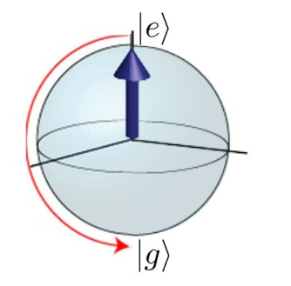
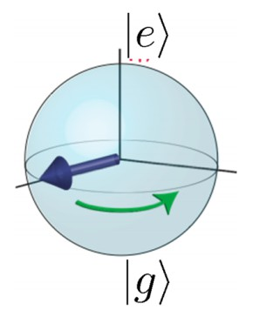
Quantum Error Correction
The cause of errors
Interaction of quantum system with environment
Energy loss &
Decoherence
Errors
Bit-flip
Energy Loss
(Decay)
Loss of quantum information
Decoherence
Dephasing

Slide 5
Quantum Error Correction
Review: Classical error correction
Redundancy encoding: Storing information multiple times
Error correction: If these copies disagree, take the majority of the correct values
Bit flip code:
Analogous to classical repetition code, this method uses three entangled physical qubits to encode one logical qubit.
Quantum Errors
Bit flip
Dephasing
Sign flip code:
Constructing three-body entangled state in the Hardmard basis.
QEC strategies
Shor code:
Shor code corrects arbitrary single-qubit errors.
Coding in groups of three
Bosonic codes:
Storing error-correctable quantum information in bosonic modes
Cat/Gottesman-Kitaev-Preskill (GKP)/Binomial

Slide 6
Cat qubit

Slide 7
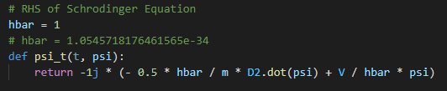
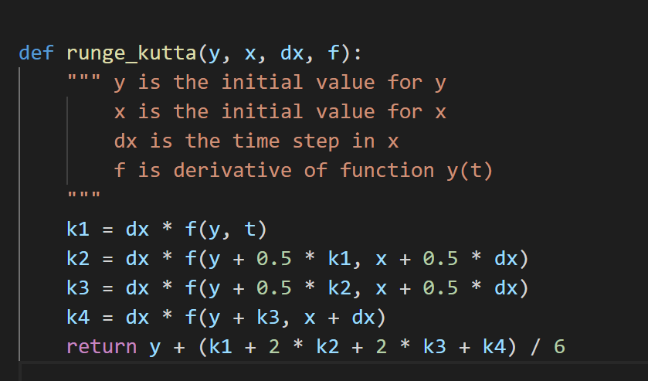
数值求解方法
定义波函数关于时间一阶导的函数
通过runge-kutta方法积分，可求出波函数任意t时刻的波函数
设定初始值并调用runge-kutta法进行积分，对应部分程序如下

Slide 8
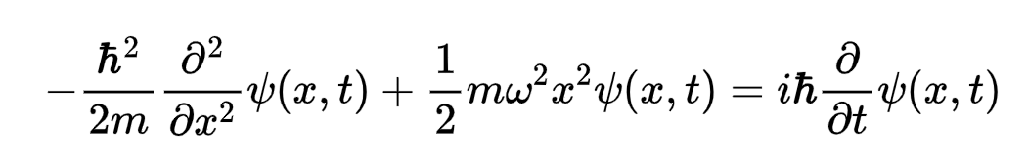
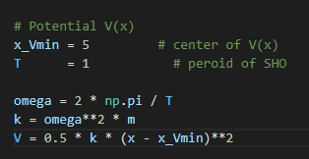
一维线性谐振子求解
一维线性谐振子薛定谔方程
不同类型的问题对应的薛定谔方程就只是势能不同，定义线性谐振子势能

Slide 9
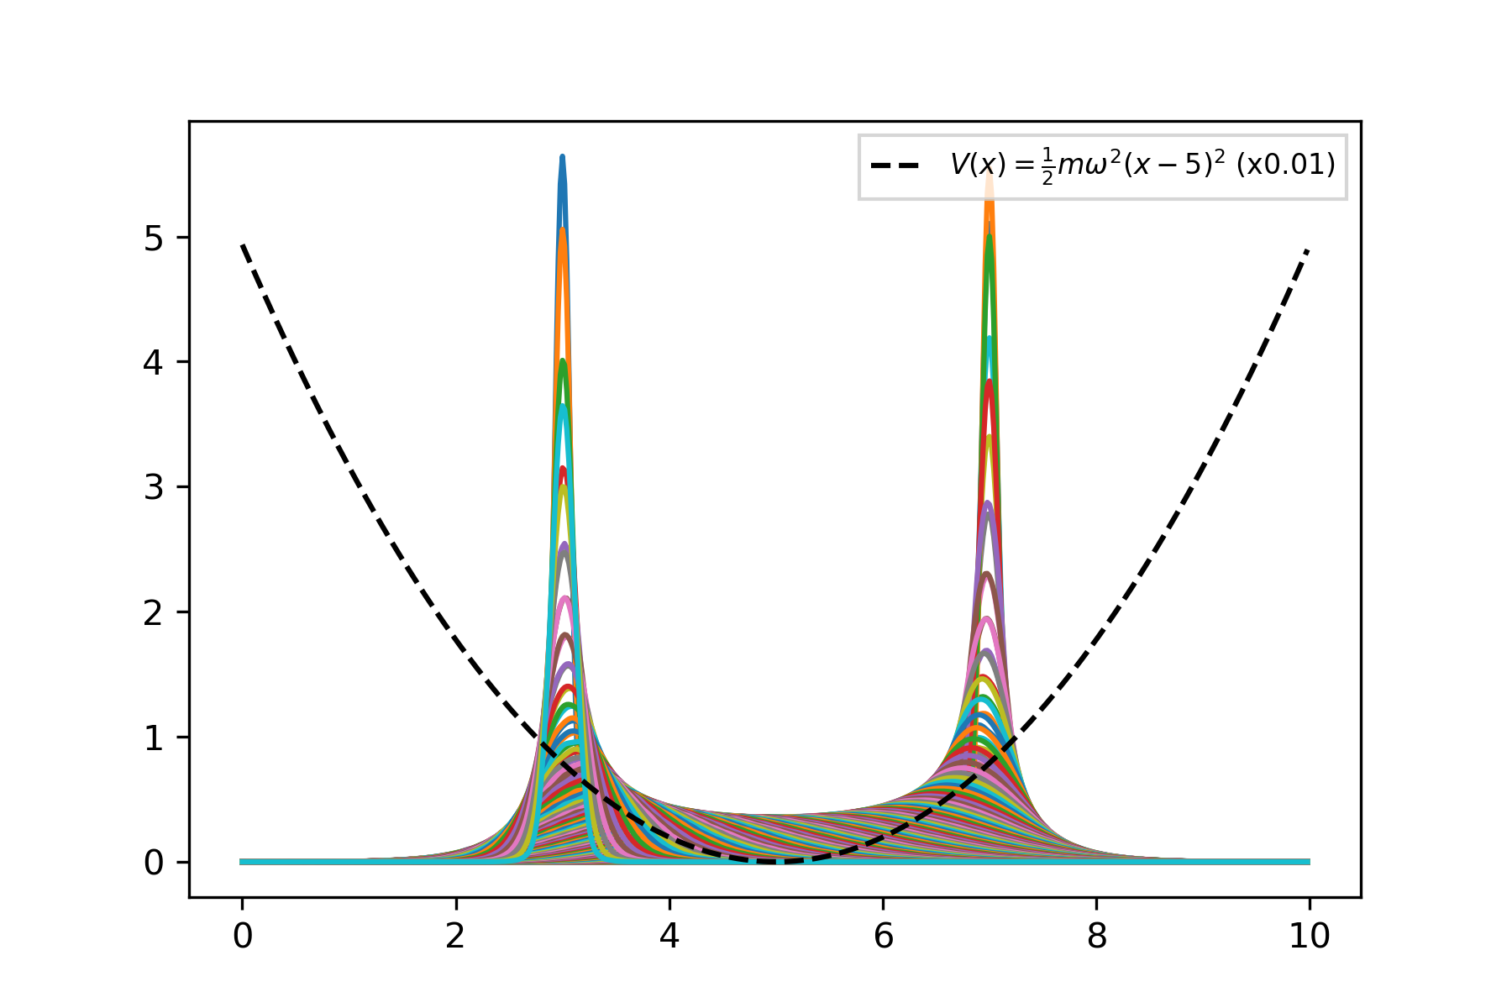
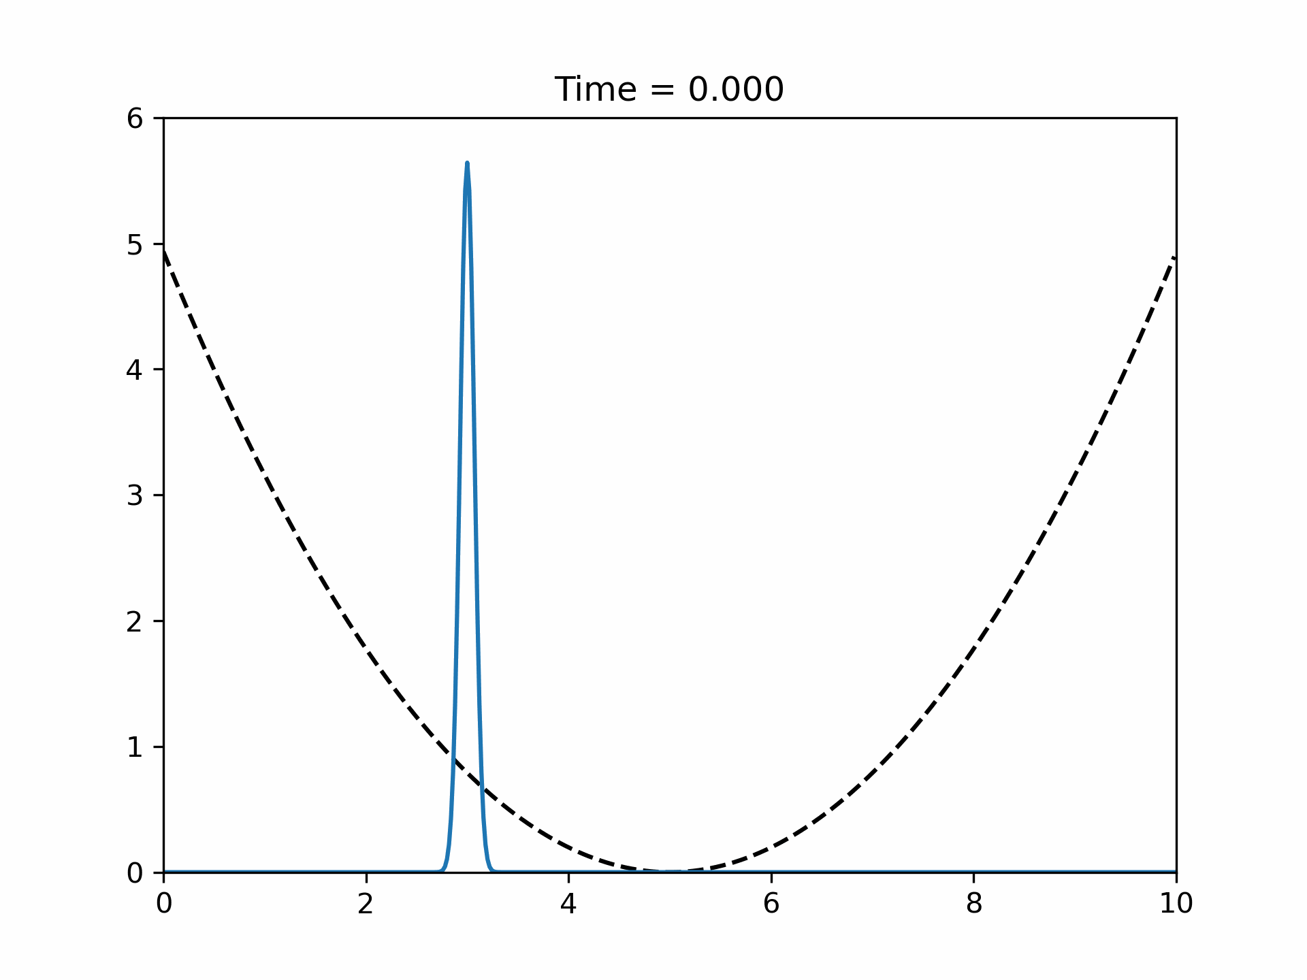
一维线性谐振子求解
运行结果
初始设置为位置处于3处的基态波函数(高斯函数)

Slide 10
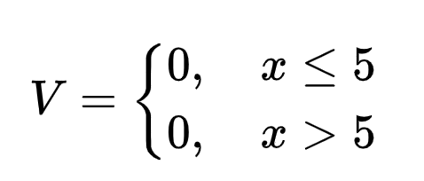
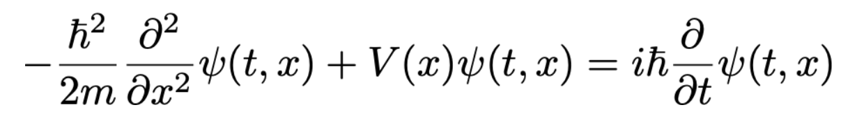
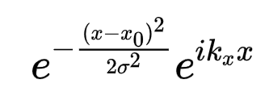
波包散射
阶梯势
含时薛定谔方程
初始状态仍然是高斯函数

Slide 11
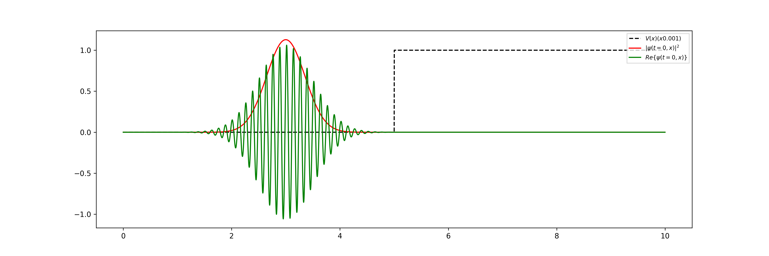
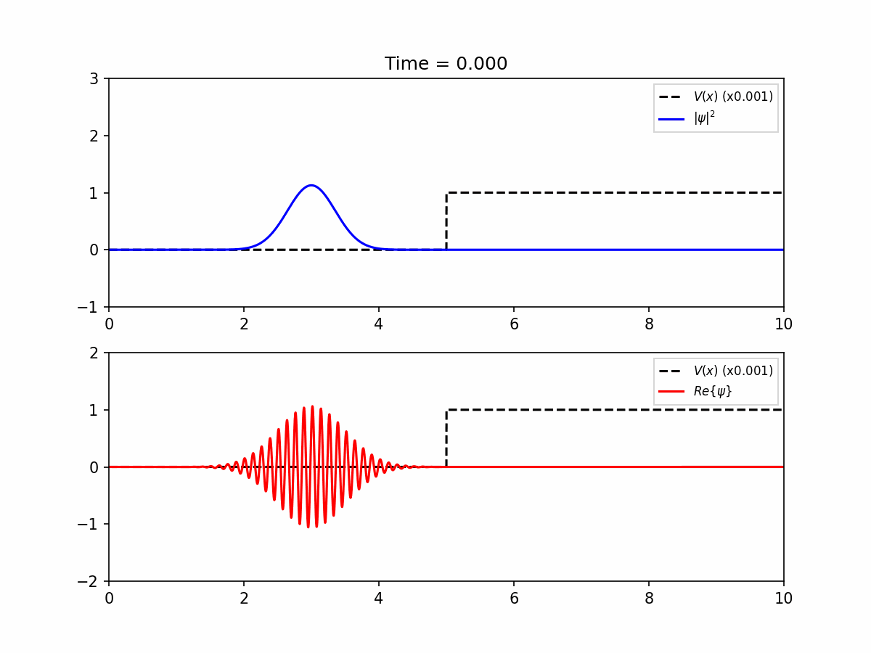
波包散射
运行结果

Slide 12
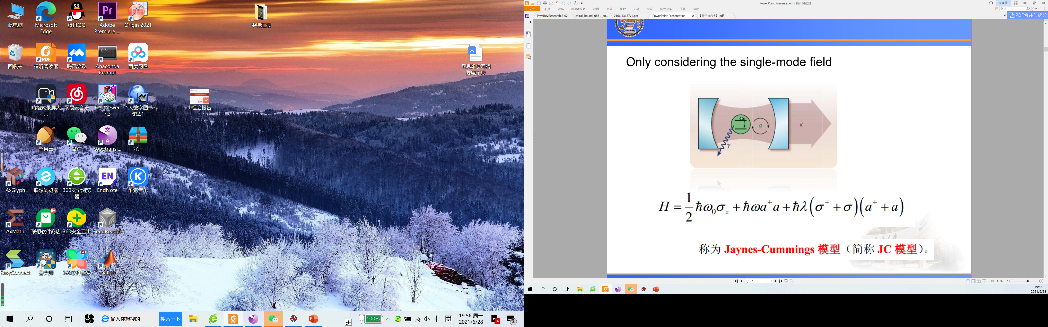
Rabi Oscillation
Interaction of a single two-level atom with a single mode field
(Jaynes-Cummings Model)
(interaction picture Hamiltonian)

Slide 13
Rabi Oscillation
Probability amplitude method
We set at time t, we have n photons in the field ,the state can be expressed as:
The interaction energy can only caused transitions between the state and so we the system state:
By solving Sch. Eq ,we can get:

Slide 14
Rabi Oscillation
At the initial time the atom is in |a> and the field is in |0>.
The inversion of the level population probabilities is
For the resonant interaction:
(vacuum Rabi oscillation)

Slide 15
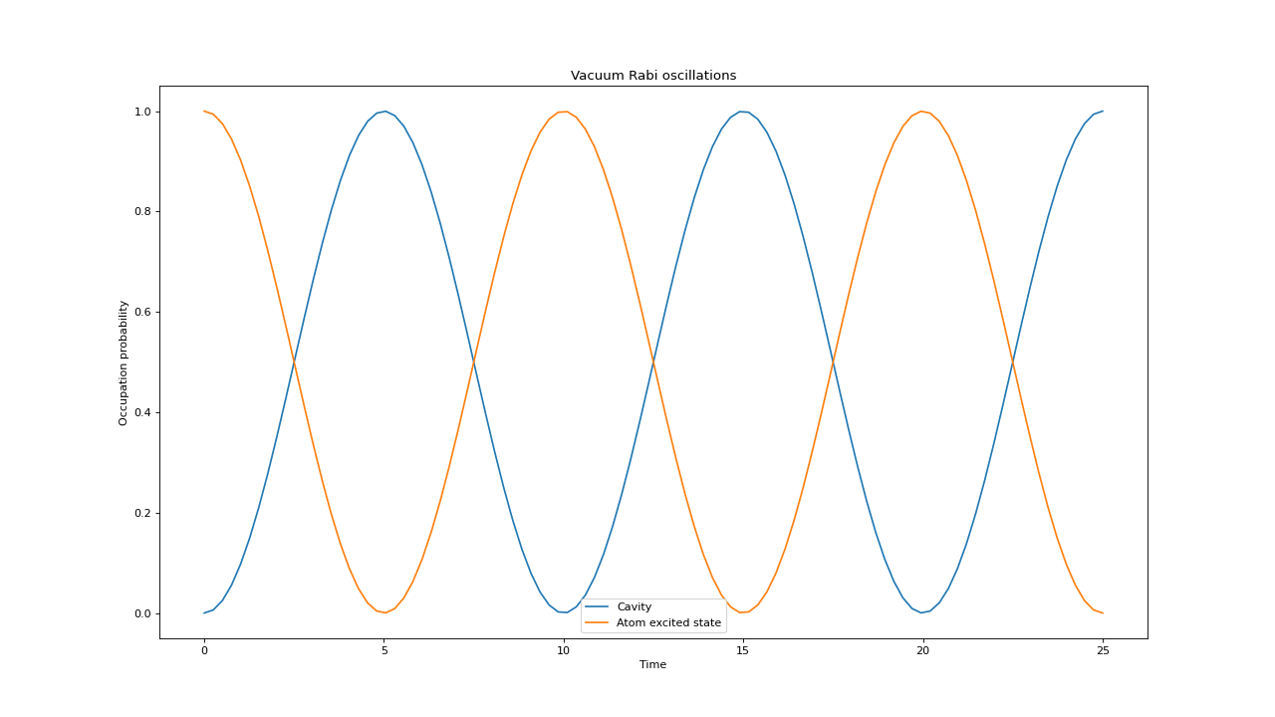
Rabi Oscillation
程序运行结果(从激发态开始演化)

Slide 16
Thank you!

